Slide 1
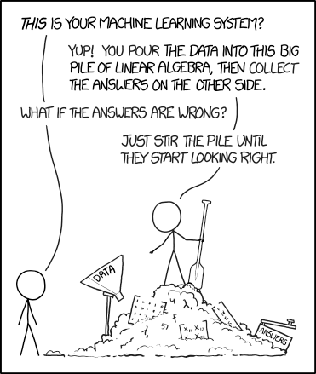
Structured writing
How it can help your AI to get the right answers for your customers.
Convoclub – 27 October 2022
© Randall Munroe (XKCD) https://xkcd.com/1838
Notes:
Before we start I want to share with you a conversation I had with the chatbot on the website of the manufacturer of my car.

Slide 2
Chatbot: Hello! How can I help you today?
Me: I need to change the battery in my key fob.
Chatbot: I understand you need to replace the battery in you key fob. I'd be happy to help you with that. But first I need to ask some questions.
Chatbot: What is the year, make, and model of your car?
Me: 2018 Acme Sedan
Chatbot: You said you have a 2018 Acme Sedan. Is that correct?
Me: Yes
Time goes by

Slide 3
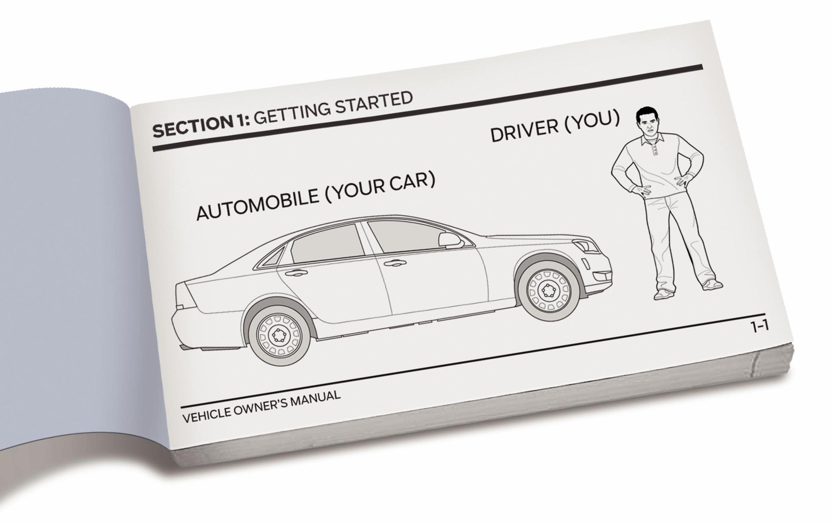
Chatbot: Here is the 2018 Acme Sedan Owner's Manual.
© Chicago Tribune

Slide 4


Hello!
My name is Patrick Andriessen
https://linktr.ee/napnampat
Notes:
Hello everyone, my name is Patrick Andriessen.
The conversation with the Acme chatbot comes from the excellent book: The Personalization Paradox, by Val Swisher and
Regina Lynn Preciado. I have however experienced similar conversations with the new chatbot at my current client.
But, before we start, let me tell you a little bit about myself. And let me start with a small disclaimer. I do not have a background in conversational design. I also do not develop chatbots or have any recent formal training when it comes to AI.
I do have a formal education in information studies and information management, where I specialized in documentary information systems, focussing on storage and retrieval techniques.
For the most part of my professional career however, I have worked as a technical communicator.
Technical communication is a very broad field and exhibits one or more of the following characteristics:
* It is communication about technology
* It is communication using technology
* It provides instructions on how to do something
Over the years I have done many different projects and filled many different roles. I have been:
* A Technical Writer and Editor
* An Information Architect
* A Project Manager and Team Lead
* An Indexer
* A Web Designer
* A Content Strategist
* An Instructional Designer and Trainer
Although I do still write and create content, I mostly do consultant work today, with a focus on content strategy and content operations. Basically, I help documentation and content teams improve their processes and tool stacks, and teach them to create smarter content that is Findable, Accessible, Interoperable and Reusable (FAIR).
Quality content. That is where it - in this case - all begins. At least, that is how I like to look at it.

Slide 5
The problem with content.
There is just so much of it.
Notes:
The problem with content in organizations, both large and small, is that there is just so much of it. Everybody within the organization generates, uses and shares content. To name a few examples:
* Sales creates proposals, presentations and pricing sheets.
* Training creates training materials and lesson plans.
* The technical publications department (if there is one!) creates instructions for use, maintenance and installation instructions, illustrated parts catalogs.
* Engineering and R&D produce information that is related to the design of the product, like technical drawings and functional descriptions.
* Marketing creates marketing materials, digital assets (video and graphics) and probably maintains the corporate brand guidelines and website.
* And so on.
All these activities produce a staggering amount of data that - because of its unstructured nature - becomes unwieldy very fast. This is not a new problem. It has been a challenge for organizations for decades. Because so many different people are producing information, finding the information that is correct, valid, and useful is a challenge.
Simply, throwing SharePoint or a similar system at the problem didn't fix it either, often because the content and documents in the system are left unattended and unmanaged. After a while you basically have the same problem again that you started out with. A large pile of information, locked into documents, that no one can find and use.
But this is not a story about content management, it is about content quality.

Slide 6
Bad answers can lead to
A missed sale
A call to an already overstretched customer support department
Someone getting hurt or worse
I think it is safe to say that we want our algorithms, like our humans, to give us good answers.
Notes:
Depending on the findability and quality of your data, an algorithm - like a human - can produce answers to questions. For the sake of simplicity, let's say that those answers can be either good or bad. Good answers help someone succeed in what they are trying to accomplish. However, depending on the nature of your organization, a bad answer can result in anything from:
* A missed sale.
* A call to an already overstretched customer support department.
* Someone getting hurt or worse.
I think it is safe to say that we want our algorithms, like our humans, to give us good answers.
So, what do we need to do first? We need to create better content!
Let's start with the basics.

Slide 7
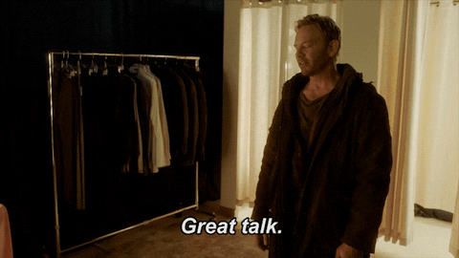
Most humans
are poor writers.
Notes:
In his book:
_Structured Writing: Rhetoric and Process, Mark Baker claims that most humans are poor writers. With 'poor writers' he does not mean that they use poor grammar or spelling. Or that they create sentences that are way to long. Or that they use the passive voice way to often_
_He means that they do not say the right things, in the right way, for the right audience. They leave stuff out that needs to be said, they weigh their text down with things that do not need to be said, or they write in a way that is way to hard to understand._
This is my experience as well. In my work as a technical communicator, I often need information that is created by subject matter experts. That information can be in any form. A technical drawing, a list, a comprehensive document. However, it is rarely the case that the subject matter expert (even though they think they did) has documented the answer to one of my questions, like:
* How does this system work?
* How does the operator perform X-Y-Z?
* How do you install this piece of kit?
In his book "The Sense of Style", Harvard psychologist Stephen Pinker, regards the curse of knowledge as the single best explanation for bad writing. The curse of knowledge makes it difficult for us to understand what it is like to not understand something we know. Because of this, we take shortcuts, we make assumptions, we are vague, and we just leave stuff out.
It is not that we are lazy or that we just don't care. We automatically assume that the person we are communicating with shares a huge collection of experiences, ideas, and vocabulary in common with us. And if those assumptions are correct, than communicating is very efficient.
Alas, what is obvious to one person, can be obscure to another. The curse of knowledge is that as soon as something becomes obvious to us, we can no longer imagine it being obscure to someone else. It is why much communications between humans fail.

Slide 8
Most humans
are poor writers.
Notes:
In his book:
_Structured Writing: Rhetoric and Process, Mark Baker claims that most humans are poor writers. With 'poor writers' he does not mean that they use poor grammar or spelling. Or that they create sentences that are way to long. Or that they use the passive voice way to often_
_He means that they do not say the right things, in the right way, for the right audience. They leave stuff out that needs to be said, they weigh their text down with things that do not need to be said, or they write in a way that is way to hard to understand._
This is my experience as well. In my work as a technical communicator, I often need information that is created by subject matter experts. That information can be in any form. A technical drawing, a list, a comprehensive document. However, it is rarely the case that the subject matter expert (even though they think they did) has documented the answer to one of my questions, like:
* How does this system work?
* How does the operator perform X-Y-Z?
* How do you install this piece of kit?
In his book "The Sense of Style", Harvard psychologist Stephen Pinker, regards the curse of knowledge as the single best explanation for bad writing. The curse of knowledge makes it difficult for us to understand what it is like to not understand something we know. Because of this, we take shortcuts, we make assumptions, we are vague, and we just leave stuff out.
It is not that we are lazy or that we just don't care. We automatically assume that the person we are communicating with shares a huge collection of experiences, ideas, and vocabulary in common with us. And if those assumptions are correct, than communicating is very efficient.
Alas, what is obvious to one person, can be obscure to another. The curse of knowledge is that as soon as something becomes obvious to us, we can no longer imagine it being obscure to someone else. It is why much communications between humans fail.

Slide 9
Patrick Andriessen
patrick@napnam.nl
+31 (0) 618 099 442
https://linktr.ee/napnampat

